Slide 1


Technical Design Thinking II
Spring 2025
MATLAB 1 – Introduction, Sequential & Conditional
Dr. Bruce McFall

Slide 2

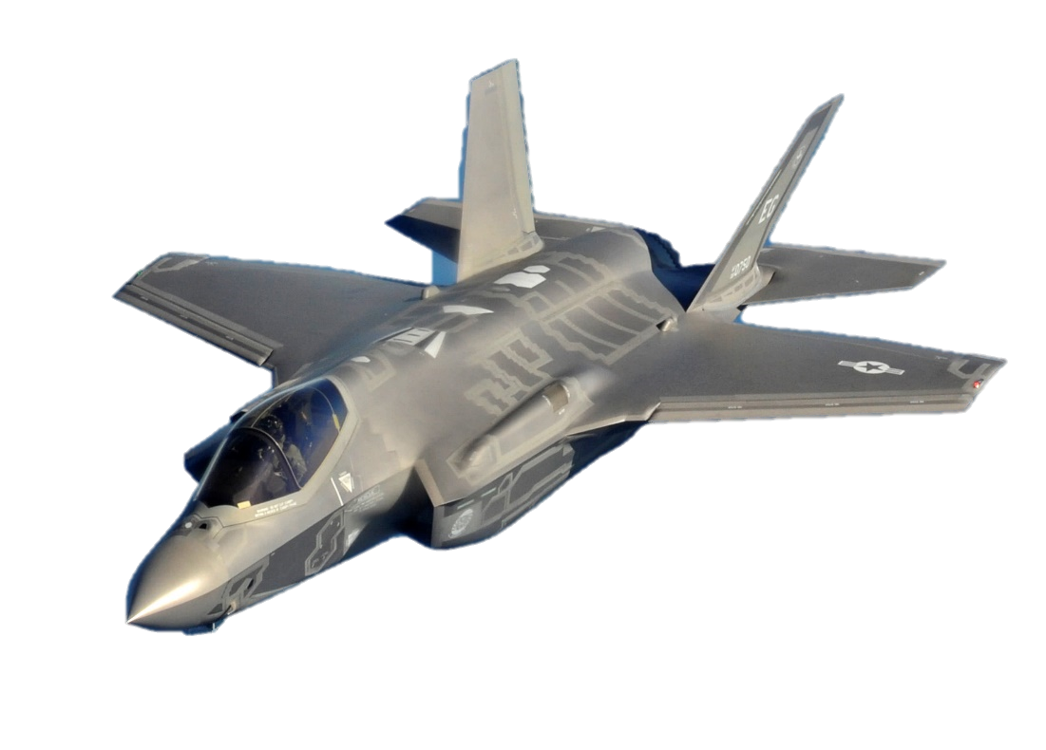
MATLAB
The MATLAB/Simulink Platform
Aerospace:
GE used MATLAB/Simulink for the Design/Modeling of the engine controls of the F-35 JSF
Automotive:
Widely used in the industry
Defense:
Used for simulations in many domains

Slide 3
MATLAB
The MATLAB/Simulink Platform
The V & V Model for Certifiable Product Development
Validation is the process of checking whether the specification captures the customer's requirements,
Verification is the process of checking that the software meets specifications

Slide 4
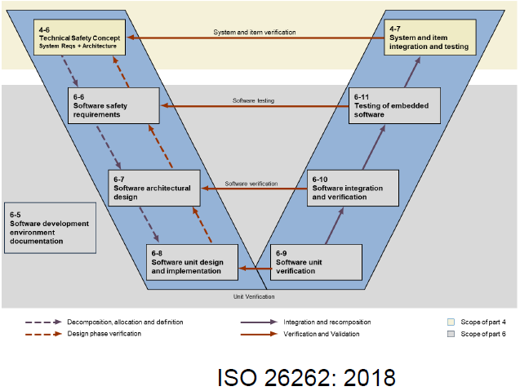
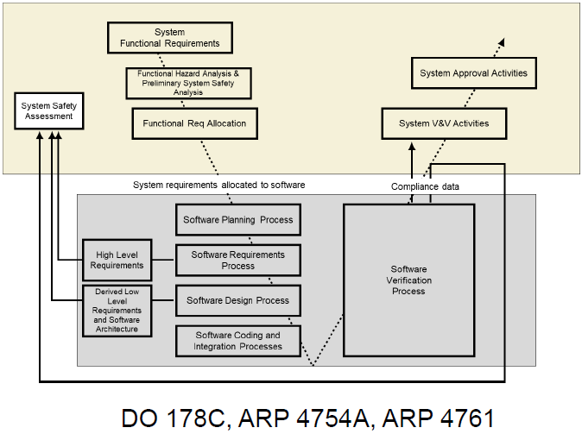
MATLAB
The V & V Model for Certifiable Product Development

Slide 5
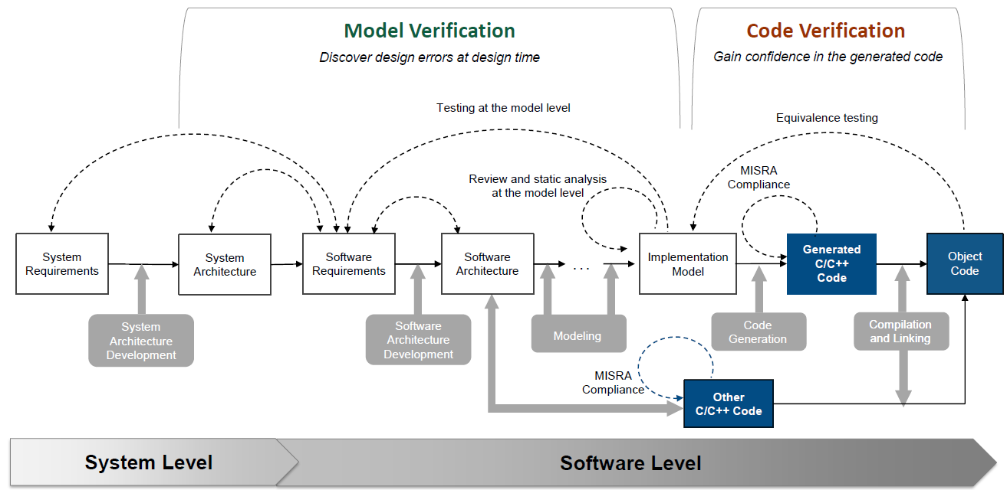
MATLAB
Reference Workflow for Certification – Static Code Verification

Slide 6
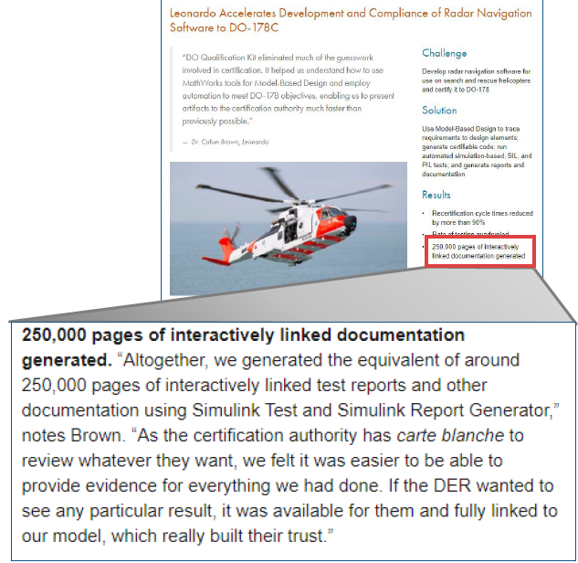
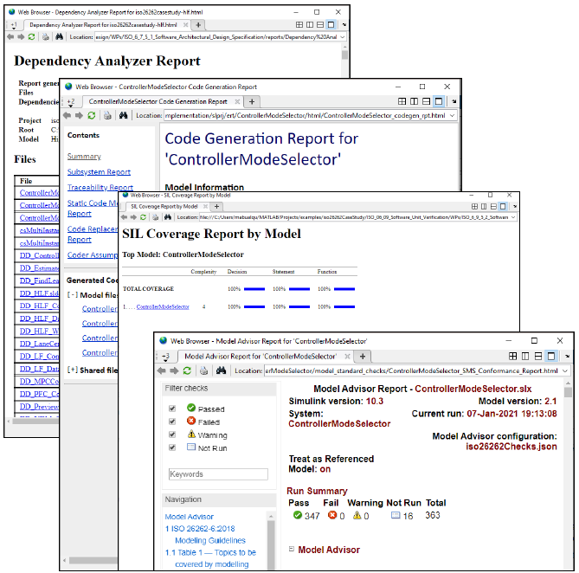
MATLAB
Automatic Generation of Documentation for Certification

Slide 7
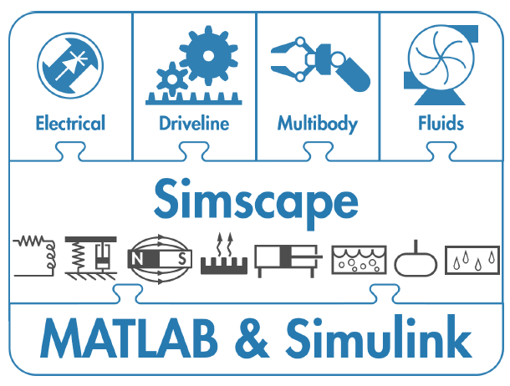
MATLAB
The MATLAB/Simulink/Simscape Multi-domain Ecosystem

Slide 8
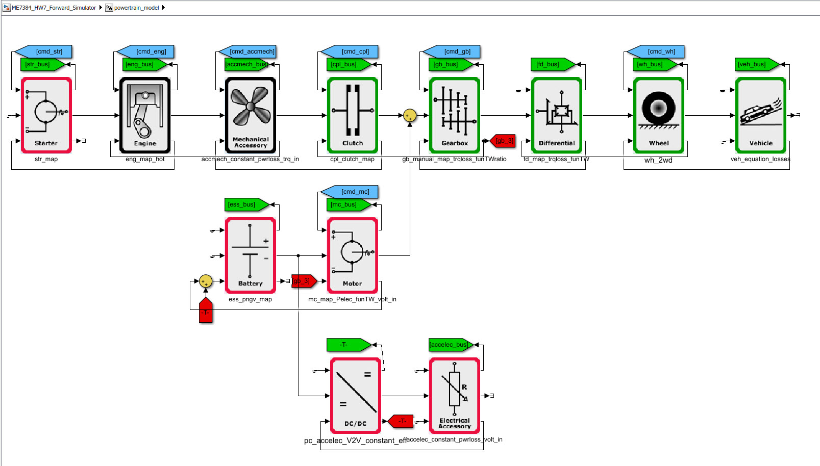
MATLAB
A MATLAB/Simulink/Simscape Example

Slide 9
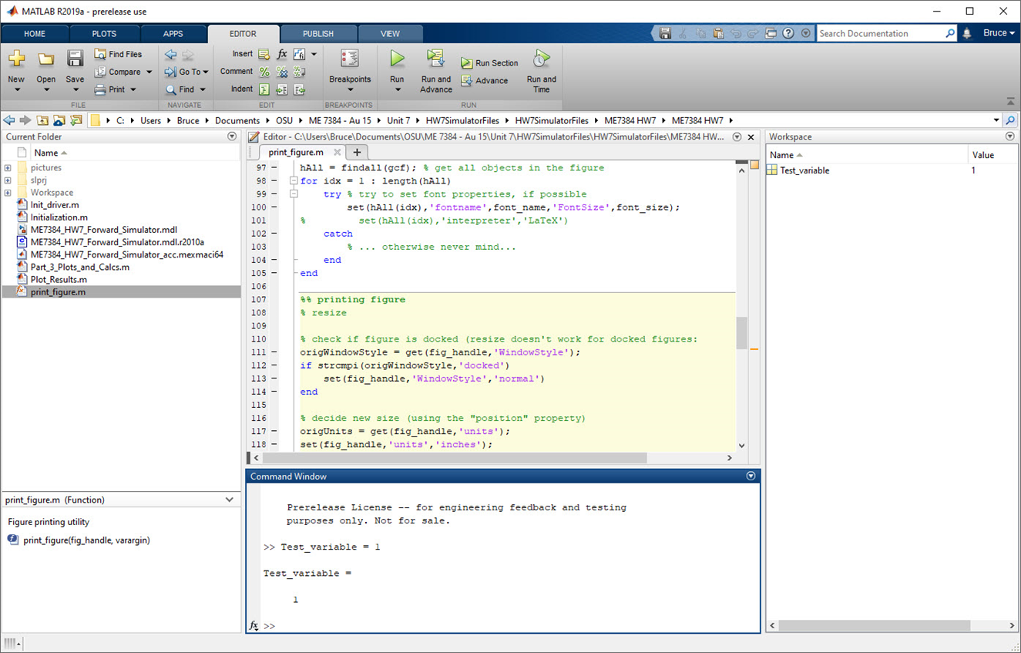
MATLAB Introduction

